Slide 1
Hands-On with
Agile Methods
Notes:
About Jason: PM & SM at CA. Mostly involved in federal DS projects. Supported some aspects of the development of this training.

Slide 2
Hands-On with Agile Methods
Agenda
Introduction
What Agile Means in a Digital Services Context
A Hands-On Agile Mini-Project
Review & Discussion
Notes:
What we’ll do today:
a quick background on Agile
what it means in the context of Digital Services
break into teams and have a hands-on exercise with Scrum
review what we learned, discuss and reflect on it all
Outcomes:
Give you a better understanding of Agile
Experience what it’s like to be on a digital services delivery team while using agile principles
Be in a better position to apply agile concepts in your contract/procurement situations
Build a foundation for agile concepts that we will build on throughout this course
Also:
Want to acknowledge a wide spectrum of Agile experience in the room
For some, this is your first exposure
For others, this may be a refresher - think of it also as an opportunity to help guide others - especially in the hands-on part, and possibly expose some gaps in your own knowledge in the process
Any questions before we begin? (I’ll stop occasionally for questions)

Slide 3
What Agile Means
Agile Manifesto
We are uncovering better ways of developing software by doing it and helping others do it. Through this work we have come to value:
Individuals and interactions over processes and tools
Working software over comprehensive documentation
Customer collaboration over contract negotiation
Responding to change over following a plan
While there is value in the items on the right, we value the items on the left more.
Notes:
In Feb of 2001, a group of software development leaders gathered at a ski resort in Utah, where they agreed on a simple set of statements about software development. It read: ….
When you think about govt procurement of digital services in its current state, do you see it more represented in the items on the left or right? There was a time when it was mostly the items on the right, and now things are starting to shift to the items on the left.
One overall goal of this learning experience is to continue that shift.
These are nice statements, but they are very broad ideas and are hard to apply to specific contracting situations.

Slide 4
What Agile Means
12 Agile Principles
Our highest priority is to satisfy the customer through early and continuous delivery of valuable software.
Welcome changing requirements, even late in development. Agile processes harness change for the customer's competitive advantage.
Deliver working software frequently, from a couple of weeks to a couple of months, with a preference to the shorter timescale.
Business people and developers must work together daily throughout the project
Notes:
The working group that came up with the manifesto also came up with 12 Agile principles that provide a guide for how those values might be applied in project contexts
Read them…

Slide 5
What Agile Means
12 Agile Principles
Our highest priority is to satisfy the customer through early and continuous delivery of valuable software.
Welcome changing requirements, even late in development. Agile processes harness change for the customer's competitive advantage.
Deliver working software frequently, from a couple of weeks to a couple of months, with a preference to the shorter timescale.
Business people and developers must work together daily throughout the project
Build projects around motivated individuals. Give them the environment and support they need, and trust them to get the job done.
The most efficient and effective method of conveying information to and within a development team is face-to-face conversation.
Working software is the primary measure of progress.
Agile processes promote sustainable development. The sponsors, developers, and users should be able to maintain a constant pace indefinitely.

Slide 6
What Agile Means
12 Agile Principles
Our highest priority is to satisfy the customer through early and continuous delivery of valuable software.
Welcome changing requirements, even late in development. Agile processes harness change for the customer's competitive advantage.
Deliver working software frequently, from a couple of weeks to a couple of months, with a preference to the shorter timescale.
Business people and developers must work together daily throughout the project
Build projects around motivated individuals. Give them the environment and support they need, and trust them to get the job done.
The most efficient and effective method of conveying information to and within a development team is face-to-face conversation.
Working software is the primary measure of progress.
Agile processes promote sustainable development. The sponsors, developers, and users should be able to maintain a constant pace indefinitely.
Continuous attention to technical excellence and good design enhances agility.
Simplicity--the art of maximizing the amount of work not done--is essential.
The best architectures, requirements, and designs emerge from self-organizing teams.
At regular intervals, the team reflects on how to become more effective, then tunes and adjusts its behavior accordingly.
Notes:
After reading…
The 12 principles get into a little more detail about how to apply Agile concepts, and in a couple minutes we’ll do a hands-on exercise so you can experience what it’s like in an agile project setting and how these principles manifest themselves in a project.

Slide 7
What Agile Means
Benefits of Agile & Problems Solved by Using it
Flexibility
Continuous Delivery of Value
Continuous Learning
Transparency
Decreased Risks
Notes:
… but first there is a bigger question to answer: Why you should use Agile. The above principles are nice and seem like they could be useful, but what are the benefits of actually using an Agile approach in a project?
Flexibility - An agile project will always be more flexible and able to embrace change than a waterfall project. You will never know LESS about a project than you do at the beginning of it…. Yet that’s exactly when requirements docs are written. An agile project allows for changing requirements as more info becomes available in the natural progression of a project
Continuous delivery of value - Again comparing to a waterfall project, developers start coding much earlier. There is “something” to see and use to gather feedback much earlier in the process
Continuous learning - goes hand-in-hand with value - when creating MVP’s, prototypes or pilots, it’s a learning tool. In the case of agile projects, learning is not just something you do at the beginning to inform a requirements document.
Transparency - Feedback loops are built into agile processes. This means stakeholders always have a better understanding of what’s going on in a project because they participate in those feedback loops. Also easier to see if something is NOT going the way it should. The work being done is on display for everyone.
Decreased risks - because of the above benefits, there is less risk that what is delivered is useless, unusable, or irrelevant. Writing a requirements document at the start of a 2 year project means that whatever is delivered at the end is already at least 2 years out of date.

Slide 8
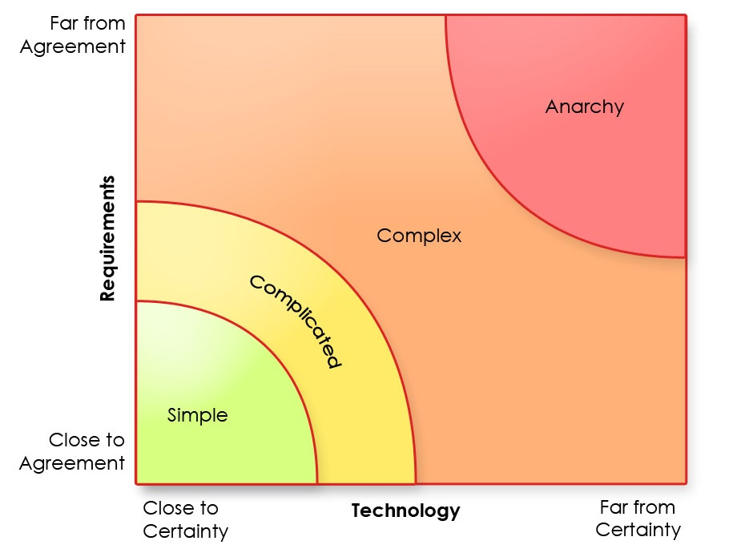
What Agile Means
Where to Use Agile Principles
Good Agile Project Candidates:
Software
Service Design
Bad Agile Project Candidates:
Buildings
Bridges
graphic: scrum-tips.com
Notes:
So we’re painting a nice picture about Agile, but it’s not always the best approach to a project.
Above: A Stacey Graph or Stacey complexity model - made by Ralph Stacey - A prof of management in UK
Explain graphic:
Simple projects = requirements are agreed upon & technology is certain
Complicated = less agreement on requirements & less certainty about tech
Complex = moving even further out on both axis
Agile delivers best results for projects in the yellow and orange areas. Green areas may be fine using traditional project approaches (waterfall).
Projects in the yellow and orange tend to be digital services projects, so Agile methods work really well in these situations - where there is either uncertainty about tech or a lack of agreement on requirements. BUT if both are in play, some experimentation may be good, to bring one or the other of these factors closer to the origin of this graph.

Slide 9
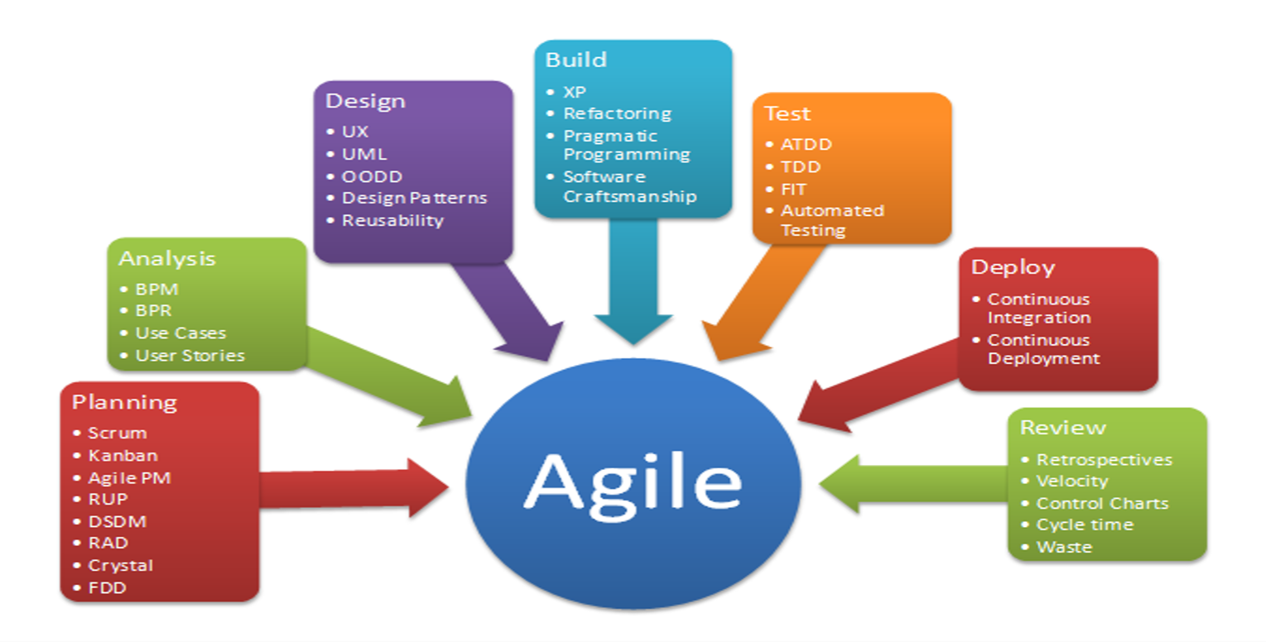
What Agile Means
Methodologies for Agile
Notes:
You have an intro to agile principles, but how do you practically apply those principles in a project situation? There are a number of methods, and choosing the most appropriate one depends on your project’s context and desired outcomes
Two methods in particular are fairly common and you’ll probably encounter them...

Slide 10
What Agile Means
Methodologies for Applying Agile Principles
Scrum
Fixed Sprints
Ceremonies
Work in cross-functional teams
Defined Roles
Teams make changes during next sprint
Kanban
Continuous flow
Just-in-time backlog
Specialized teams
Focus on efficiency and Lean practices
Limit work in process
Notes:
Two of the most common for digital services projects are scrum and kan-ban (or khan-bhan)
We’ll get hands-on with the scrum process in a moment and I’ll step you through what that typically looks like. Consists of a fixed time period (iteration) called a sprint. Specific ceremonies help apply agile principles.
Kan-ban - not so iteration-focused, more continuous, fewer ceremonies. This is a good method to deploy when priorities change quickly, or when a project is in maintenance phase.
Any questions so far?

Slide 11
Activity Time!
Notes:
Reasons for this: Get a feel for scrum. We’ll run 2 sprints - 2 iterations. I’ll step you through the first one, then you fully run the second one.
Will be more tactical than you’re likely to personally experience in a project, but it’s a good way to experience an agile workflow
Also, it’s a great way to tune up your BS detector when evaluating vendors.

Slide 12
Activity:
Create Scrum Teams
Notes:
Team creation - single file line from most experienced with Agile to least.
Count off by 4’s
Once teams defined, we’ll talk about roles on the team

Slide 13
Getting Hands-On
Scrum Team Roles
Scrum Master
- Facilitates Meetings
- Is a Servant Leader
- Has No Formal Authority
- Coaches Team on Using Agile Principles
- Removes Impediments
Product Owner
- Owns the Product Backlog
- Prioritizes Work
- Decides When to Ship Product
- Is the Single Source of Truth for Project Requirements
Team Member
- Decides How to Accomplish Sprint Work
- Communicates with PO on Level of Effort
- Performs work in sprint
Notes:
Scrum teams are flat - nobody on the scrum team has authority over other people on that same team.
Teams: assign 1 SM, 1 PO, x number of team members
Note: there is nobody on this team that is “in charge”. Teams are self managed and self-organizing.
Scrum master = a facilitator and servant leader
Product owner = represents user needs and desires
Team members = performs tasks in sprints

Slide 14
What Agile Means
Iterations, Feedback Loops, MVPs
Iteration: A fixed time period of product development. In Scrum, iterations are “sprints”.
Feedback Loop:
PLAN
BUILD
ADJUST
INSPECT
Notes:
Explaining some terms I’ve been using:
Iteration: A fixed time period of product development. In Scrum, iterations are “sprints”
Feedback loops: What makes agile projects agile are their use of feedback loops. Simplified, it means: plan, build, inspect, adjust, then repeat. And repeating is key - doing this loop over and over is how we continuously learn about what a user wants in a product. If we integrate those learnings into future iterations, we achieve a better product and deliver more value.

Slide 15
What Agile Means
Iterations, Feedback Loops, MVPs
MVP: Minimum Viable Product
A product with just enough features to satisfy early adopters
and to provide feedback for future product development
The MVP is a learning tool
Notes:
Read slide
Also, the MVP is the thing that you present at the end of an iteration. You present it to stakeholders (users, project sponsors) in order to get feedback. Keep in mind that sometimes feedback may be confirmation that you’re going in the right direction.

Slide 16
Getting Hands-On
Sprints & Timeboxes
Sprint: A time-limited period of development, typically 1-4 weeks long, where the delivery team works to complete a product iteration.
Timebox: A previously agreed amount of time for a planned activity to take place.
Notes:
A couple more terms for the group:
Sprints are typically 1-4 weeks in a development project.
Today, our sprints will only last a few minutes. Our sprints will consist of some timeboxed ceremonies which I will explain as we go.
A timebox is a (read slide).
Note: - It’s agreed upon in advance
It helps us recognize that there are priorities beyond the current activity
It helps us respect others’ time

Slide 17
Mini-Project
Scrum Exercise
Notes:
Distribute project packets, explain paper prototype concepts

Slide 18
Activity:
Create A
Product Backlog
Notes:
To prepare for our future sprints, we need to create a backlog of work that needs to be done

Slide 19
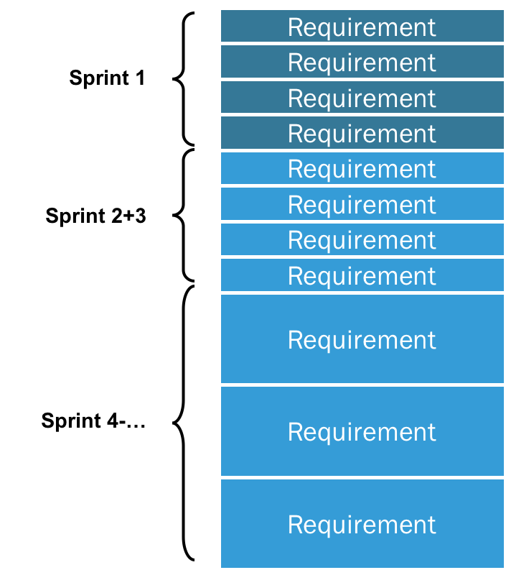
Getting Hands-On
The Product Backlog
A list of all work to be done in a project
Owned by the Product Owner
Ordered from highest to lowest priority
Replaces the traditional requirements list
Any team member can add items to it
Refined continuously and is never complete
graphic: scrum.org
Notes:
In a moment, you’ll need to create a product backlog.
(read slide)
Putting things in the product backlog doesn’t necessarily commit the team to completing them.
Any questions?
5 minutes

Slide 20
Activity:
Plan Sprint 1

Slide 21
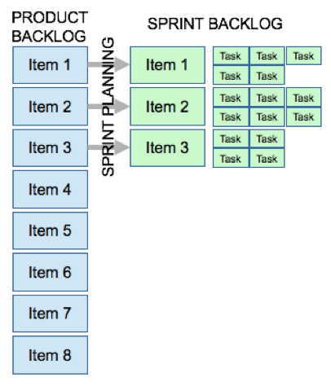
Getting Hands-On
Sprint Planning
Attended by the scrum team
Team decides together the goal of the upcoming sprint: what to deliver and what the MVP will look like
Work is selected from the backlog and put into a sprint backlog
graphic: scrum.org
Notes:
Your outcome of the sprint planning meeting is a sprint goal and a sprint backlog that, when completed, achieves your sprint goal. Thinking about your MVP will help this process.
Typically this may mean breaking items in the backlog into discrete tasks, but we may not have time for that, or your backlog items may already be in task form.
PO may need to provide clarity and detail on some items as they are considered for the sprint.
5 minutes to come up with a goal and a sprint backlog that gets you there
NOTE: As you plan your sprint, keep in mind that your timebox for performing these tasks is 7 minutes
Any questions?

Slide 22
Activity:
Perform Sprint 1 Work
Notes:
7 minutes
Team members should work on the items in the sprint backlog.
The outcome: completion of the tasks in the sprint backlog.

Slide 23
Getting Hands-On
Daily Stand Up Meetings
AKA: “daily scrum” or “scrum”
Attended by the scrum team
Each person answers the questions:
  What did you do yesterday?
  What will you do today?
  What is blocking you from making progress?
  What is your balance score?
15 minutes or less
Notes:
Daily meetings: great for transparency, for identifying blockers
Not the place for: chit chat, problem solving
An important CA customization that is highly recommended: Balance Scores

Slide 24
Activity:
Sprint 1 Review/Demo

Slide 25
Getting Hands-On
Sprint Review / Demo
Attended by the scrum team and stakeholders
This is where inspecting and adapting happens
Team members demonstrate the completed work
Outcomes:
  Feedback!
  Updates to the product backlog
Benefits:
  Continuous learning
  Transparency
Notes:
5 minutes
Go one by one through your completed sprint backlog items.
Stakeholders attending may have questions, concerns, or feedback. This is normal and acceptable.
These conversations should bring about changes to your product backlog.

Slide 26
Activity:
Sprint 1 Retrospective

Slide 27
Getting Hands-On
Sprint Retrospective
Attended by the scrum team
An opportunity to stop, breathe, appreciate, reflect, make changes
Discussion and reflection of:
  What went well in the sprint
  What could be improved
  What the team commits to improving in the next sprint
Outcome: 2-3 new practices or changes for the team
Notes:
5 minutes
Retrospectives are blameless exercises

Slide 28
Getting Hands-On
Sprint Retrospective
The Prime Directive:
“Regardless of what we discover, we understand and truly believe that everyone did the best job they could, given what they knew at the time, their skills and abilities, the resources available, and the situation at hand.”
-Norm Kerth, Project Retrospectives: A Handbook for Team Review
Notes:
5 minutes
Retrospectives are blameless exercises

Slide 29
Getting Hands-On
Backlog Grooming (aka: backlog refinement, story time)
Performed by the product owner, assisted by the team
A continuous process of:
  Removing irrelevant items from the backlog
  Creating new items based on new info or feedback
  Prioritizing items
  Estimating items that are not yet estimated
  Updating items with new information
Benefits: helps focus on and deliver highest value items first
Notes:
A side note:
During the sprint, the PO should refine, or groom, the backlog.

Slide 30
Activity:
Sprint 2

Slide 31
Sprint 2
Sprint Planning (5 min)
Perform Sprint Work (7 min)
Daily Stand Up Meetings (n/a)
Sprint Review (5 min)
Sprint Retrospective (5 min)
Total Timebox: 20 Minutes
Notes:
Sprint 2: run it yourselves! Scrum masters facilitate.
Your total time for sprint 2 (all ceremonies) is 22 minutes. Ghosted timeboxes from the previous sprint are above, but I encourage you to adjust as needed. You’re a self-organizing team now and you know what’s best for your situation.
Be aware that the time ratios are skewed here due to the abbreviated nature of this exercise. Obviously the “perform sprint work” would usually take up a larger portion of the total allotted time.

Slide 32
Scrum Review
Product Backlog
PROCESS CHANGES
Sprint Planning
Sprint Work
Demo / Review
Retrospective
FEEDBACK
Notes:
This diagram is a quick review of what we did today. (Walk through diagram)
Note the feedback loops: both from the demo/review process, which informs changes to the product backlog, and from the retrospective process, which informs changes to process in any step of scrum.
Also: Note that after 2 iterations, you have 2 valuable items: 1. An MVP 2. An updated product backlog
And: This exercise is meant to give you a sample of what an agile workflow feels like. Not all will be run exactly this way. Scrum is a good starting point.

Slide 33
Open Discussion
Notes:
Questions:
How did sprint 2 go?
What did you learn today?
How would you describe that experience compared to other project situations you’ve been in? What’s different about it?
Did anyone revert to more familiar or traditional project approaches?

Slide 34
Thank you.

Slide 36
Appendix Slides

Slide 37
Hands on Agile - Appendix Slides
Lean Development - Guiding Principles
Eliminate Waste
Build Quality In
Create Knowledge
Defer Commitment
Deliver Fast
Respect People
Optimize the Whole

Slide 38
Hands on Agile - Appendix Slides
Retrospective Formats
Plus, Delta
Start Doing, Stop Doing, Keep Doing
Liked, Learned, Lacked, Longed For
Mad, Sad, Glad
Force Field Analysis (What is driving us forward? What is holding us back?)

Slide 39
Hands on Agile - Appendix Slides
User Stories
Format:
“As a [type of user],
I want [some feature]
so that [some desired outcome].”

Slide 40
Hands on Agile - Appendix Slides
Estimation & Story Points
Estimating is a guess
Story points estimate User Story Level of Effort
  1, 2, 3, 5, 8, 13, 21 (Fibonacci) is a common scale
Hours estimate work at task level

Slide 41
Hands on Agile - Appendix Slides
Roadmaps
Are a guide, not a promise of delivery
Should reflect the overall project vision
Keep it simple

Slide 42
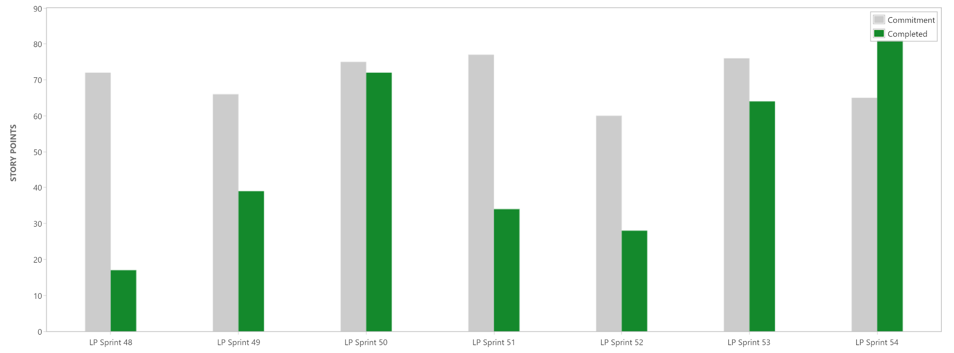
Hands on Agile - Appendix Slides
Sprint Metrics: Velocity
Measured in story points completed per sprint
Sprint velocity increases over time, but is variable

Slide 43
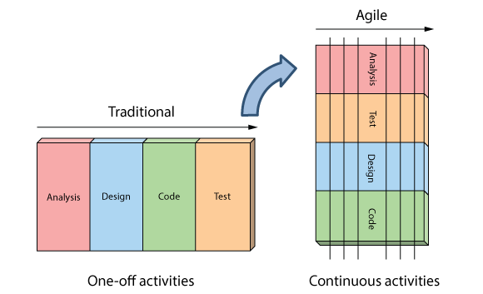
Hands on Agile - Appendix Slides
Agile vs Waterfall
graphic: agilenutshell.com
Notes:
What happens if you run out of time in a traditional project? What gets cut? Quality? Maybe even delivery?
In an agile project, you have a fully functioning product much earlier.

Slide 44
Hands on Agile - Appendix Slides
New Methods = New Language
Waterfall Contracting | Agile Contracting
Individual Labor Categories | Agile Teams
Labor Rates or FFP completed system | New Unit of Measure: FFP Per Iteration
One Final End Solution | Repeated process for functional product
Full Solution Released (IOC/FOC) | Release Management / Minimum Viable Products
Maintenance becomes Steady State | New development / bugs / enhancements prioritized equally as User Stories
New/Changed Features = Modifications for New Cost/Schedule | New features = longer schedule to completion or reprioritization of effort underway
Formal Past Performance | Performance Retrospectives
Project Management | Product Owner
Full scoped out requirements | “Just in Time” Requirements in User Stories

Slide 45
What Agile Means
Where to Use Agile Principles
graphic: scrum-tips.com
Notes:
So we’re painting a nice picture about Agile, but it’s not always the best approach to a project.
Above: A Stacey Graph or Stacey complexity model - made by Ralph Stacey - A prof of management in UK
Explain graphic
Agile delivers best results for projects in the yellow and orange areas. Green areas may be fine using traditional project approaches (waterfall).

Slide 46
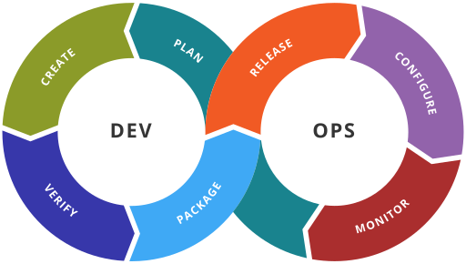
Hands on Agile - Appendix Slides
DevOps (Development Operations)
A method of software development that shortens the development cycle
Delivers updates and features frequently

